Slide 1
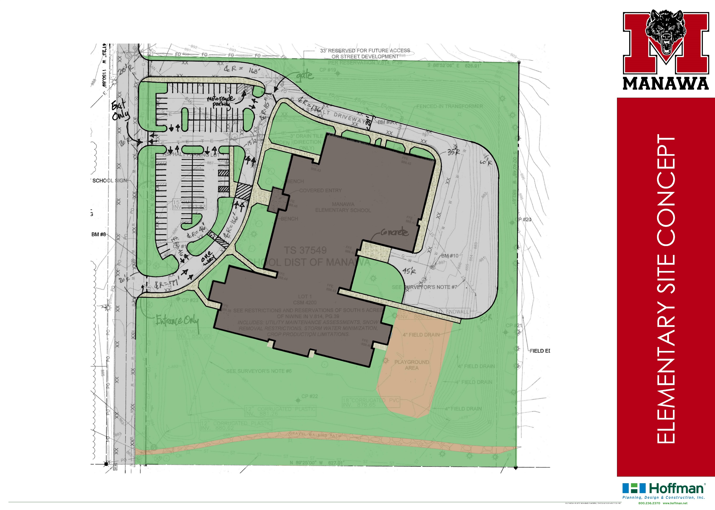
Concept Features
Bus entry, exit and drive are separate from visitor and parent entry and drive
Additional area behind building for bus traffic and turn-around; area is used during the day for playground and deliveries
New parking and sidewalks
Gate separates bus traffic from other traffic
Addition of 5 parking spaces from existing parking lot size
North end of parking area has been revised to turn parking direction
Bus drive has been revised to ease turns

Slide 2
Concept Features
Early childhood will be placed in existing classroom
Two existing classrooms with be combined to create the 4K classroom
A new accessible bathroom and new storage room will be created in the 4K classroom
Casework will be relocated and sinks will be added in the 4K classroom (north end)
A new bathroom with roll-in shower and area for changing table will be created adjacent to the early childhood classroom
New access doors between the OT/PT, early childhood and special education classrooms

Slide 3
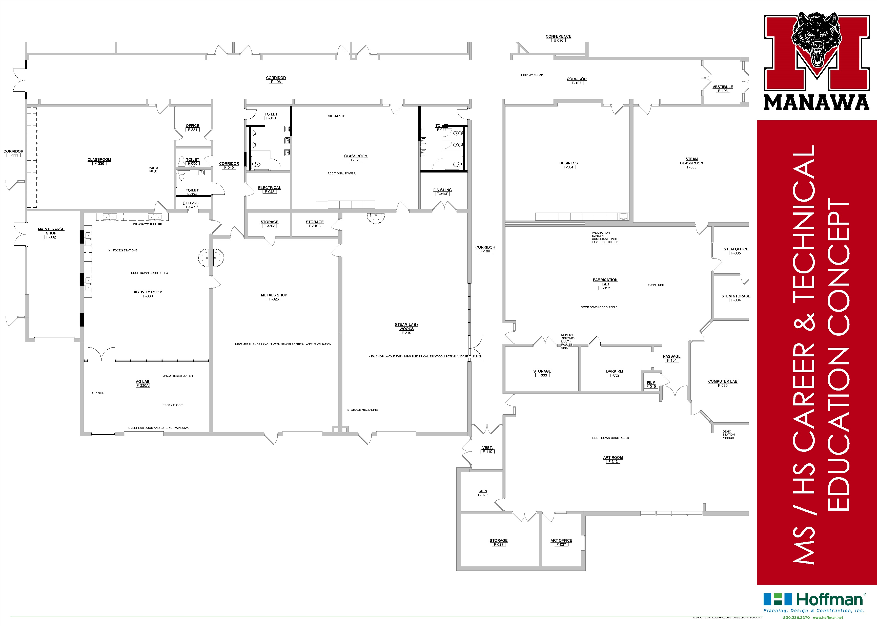
Concept Features
New student bathrooms created in this area
New staff bathroom created
Convert shop storage rooms into maintenance shop with exterior overhead door and interior doors
Create Ag activity lab with food science stations
Create Ag lab for animal and plant sciences with exterior overhead door and windows
Provide new electrical and ventilation for revised metal shop
Provide new electrical, ventilation and dust collection for STEAM and woods lab with windows and doors to promote collaboration

Slide 4
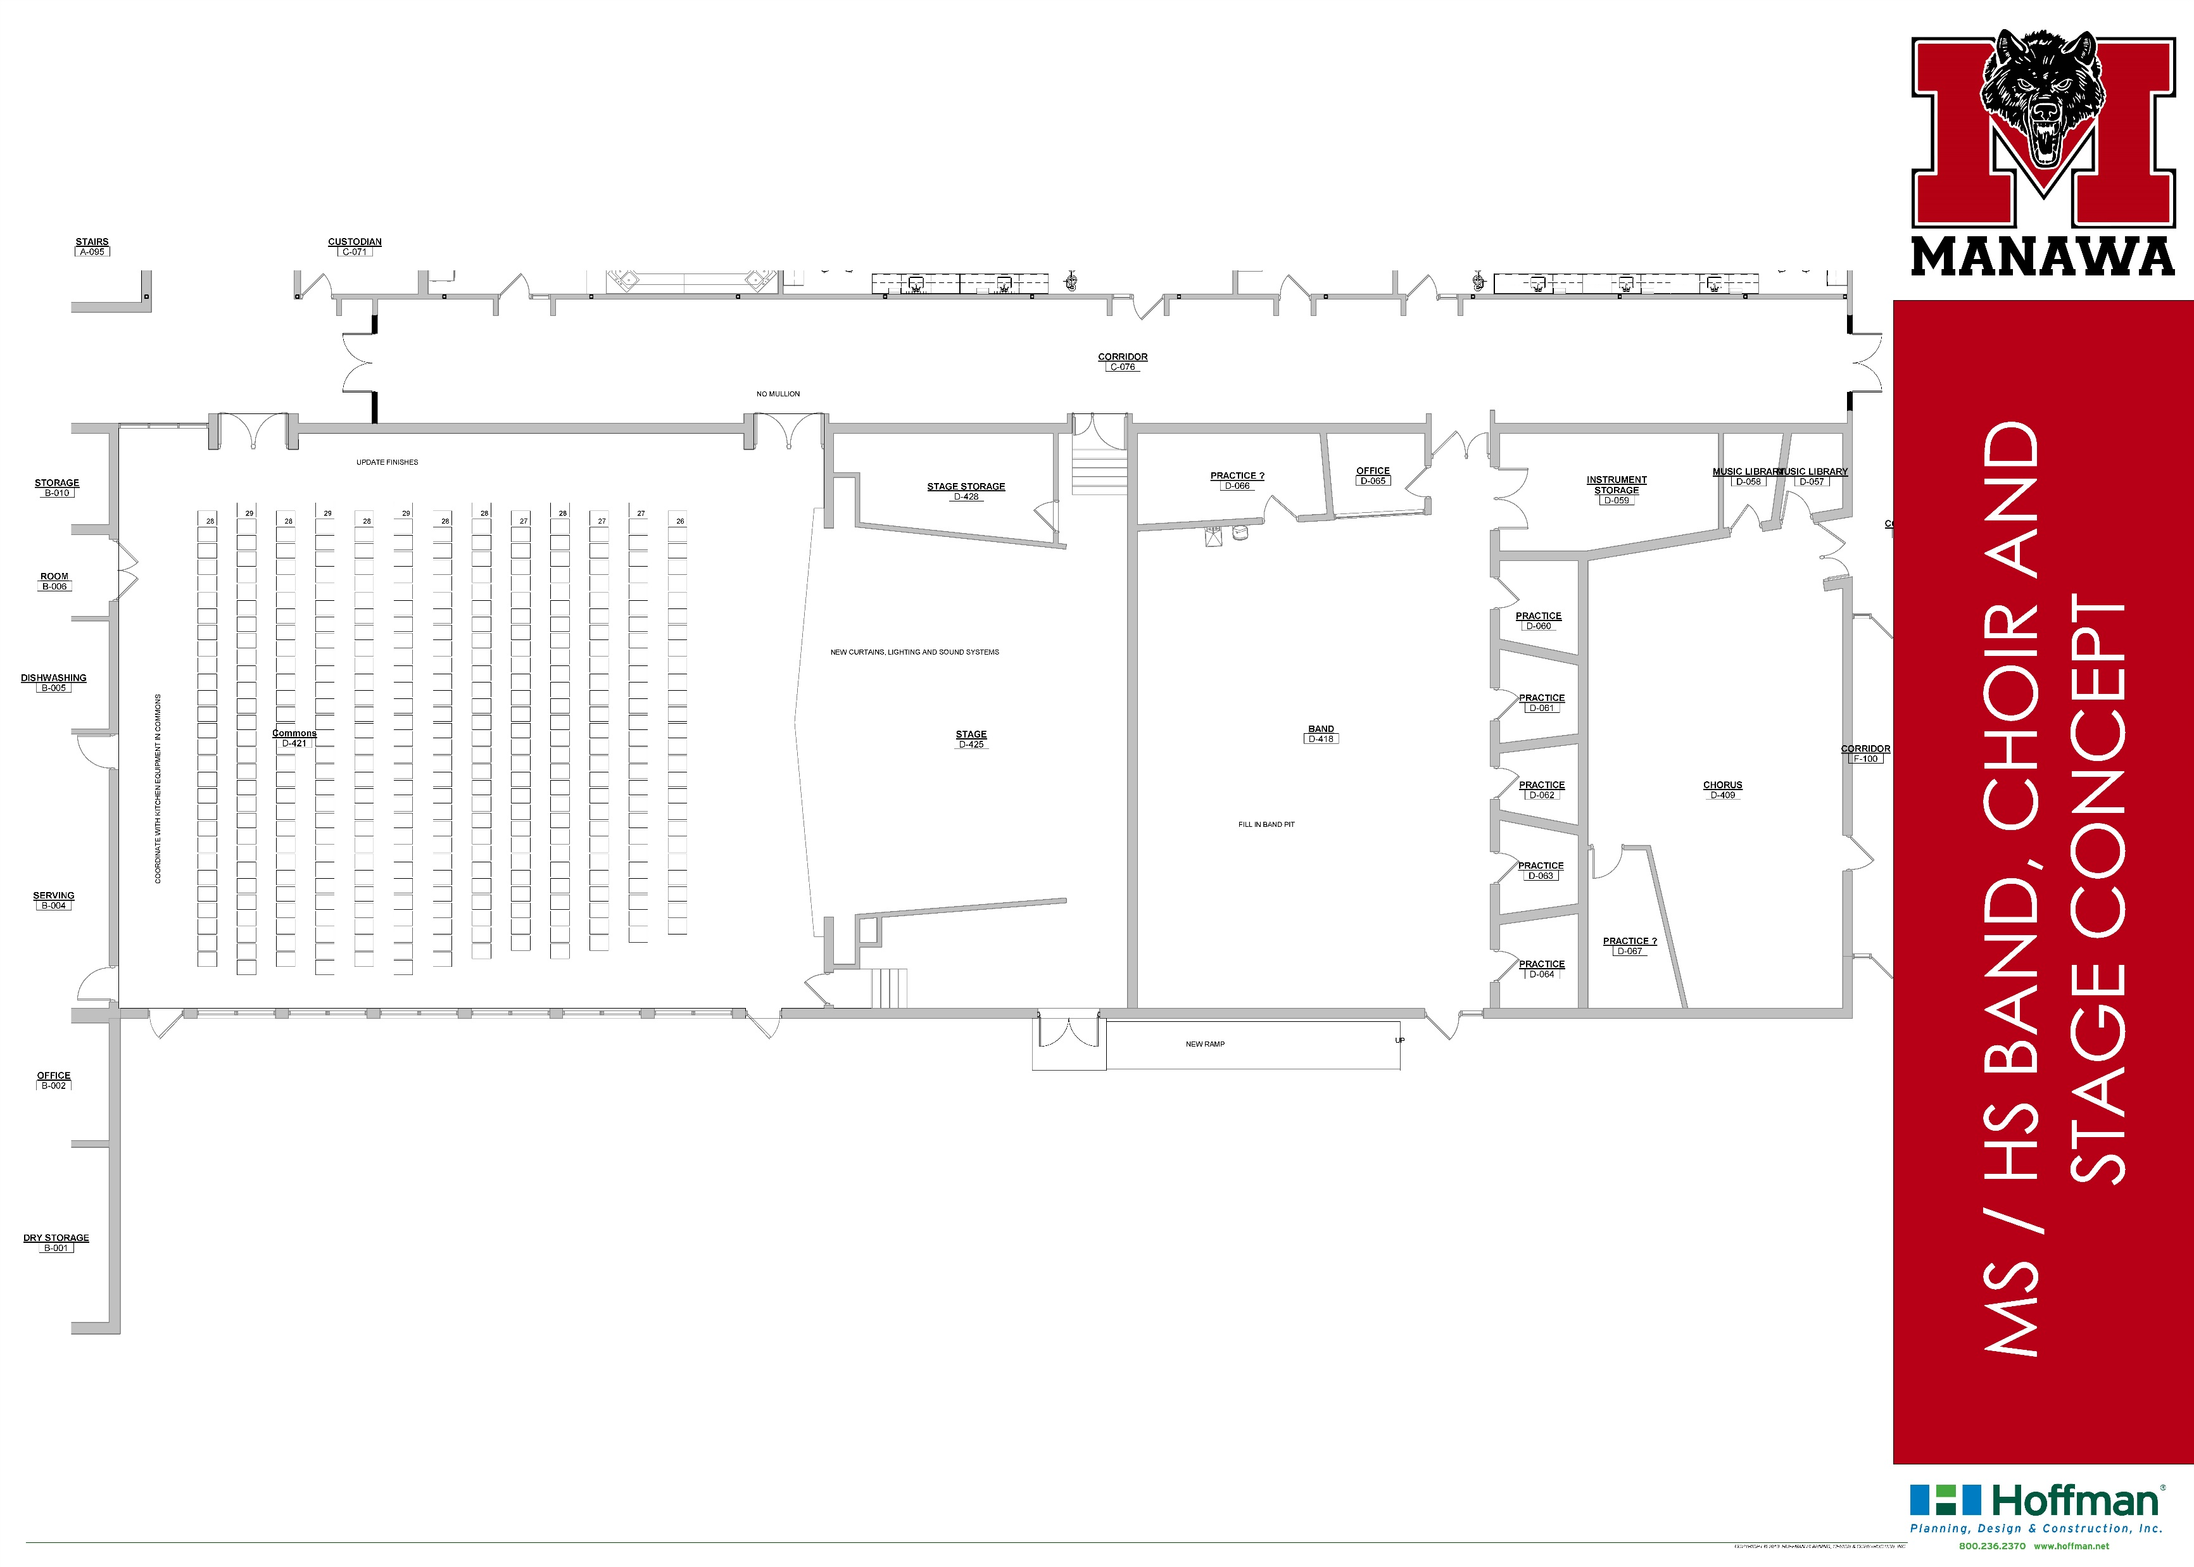
Concept Features
Provide new curtains, lighting and sound system for stage area
Coordinate kitchen and serving equipment in the commons with new theatrical system storage
Provide new finishes for commons
Fill in pit floor in band room
Provide new ramp up to stage level
Provide chair lift up to stage level

Slide 5
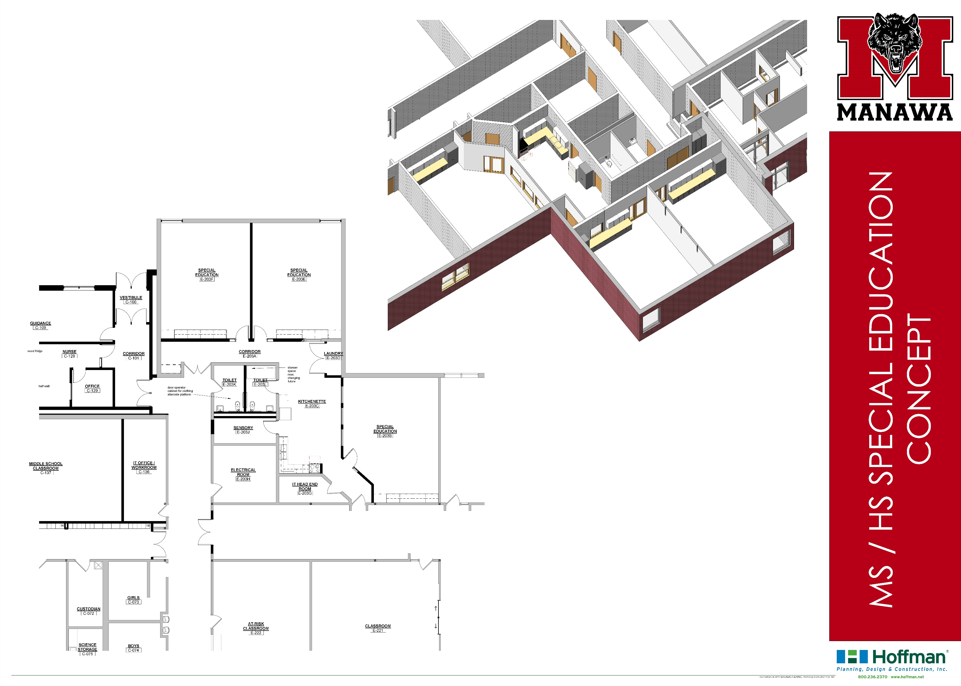
Concept Features
Remove risers and convert computer lab into 2 special education classrooms
Remove riser and convert IT workroom into special education classroom
Construct living skills area with kitchenette and laundry areas in a shared area between and connecting the special needs classrooms
Construct accessible toilet room as part of the suite
Construct accessible toilet for specific student needs that can be removed or altered in the future

Slide 6
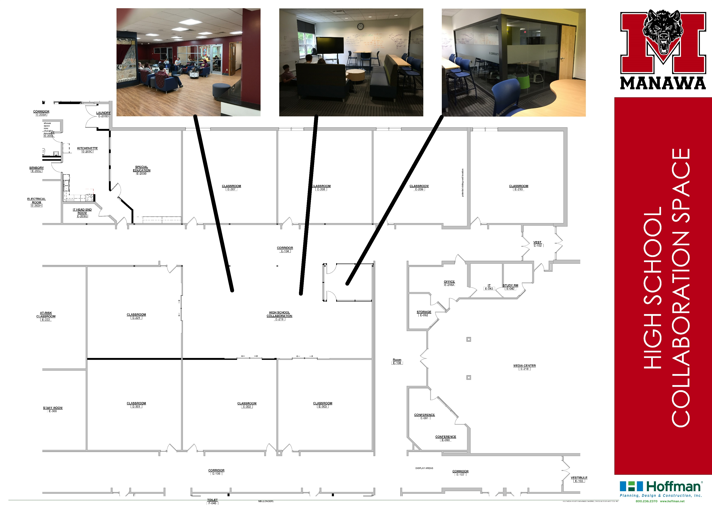
Concept Features
Provide high school collaboration area by removing walls from two classrooms
Construct quiet study or collaboration room
Remove accordion partitions and construct permanent walls in existing classrooms
Provide sliding glass doors in existing walls to promote access to collaboration areas
Provide flexible furnishings and writable walls in collaboration area

Slide 7
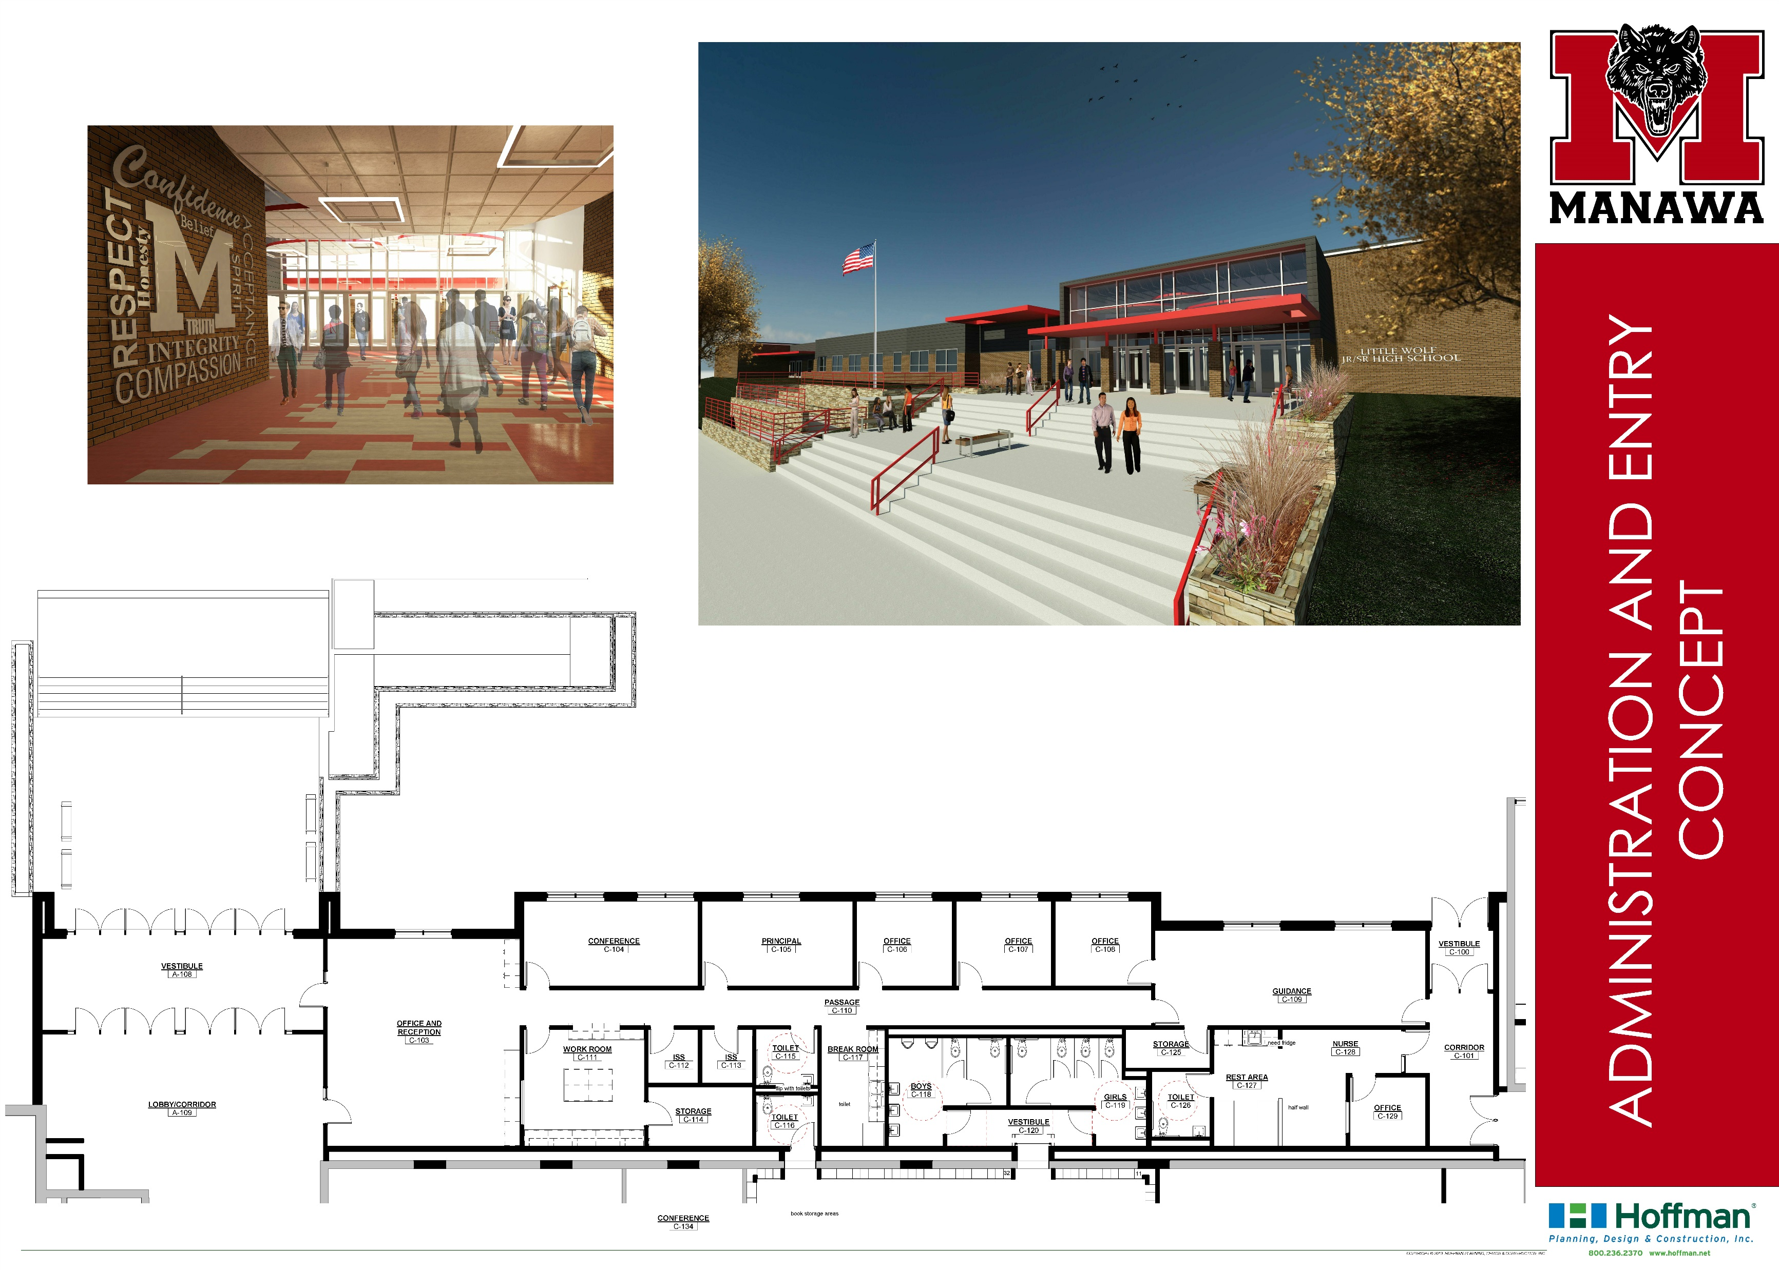
Concept Features
Secure entry concept where all visitors must travel through the office to gain access during school hours
New entry is more open and welcoming
New accessible entry with stairs and ramp
New addition houses offices for administration to create space internally for middle school area
New space includes bathrooms for middle school area
Spaces incorporate all high school and middle school administrative spaces in one area

Slide 8
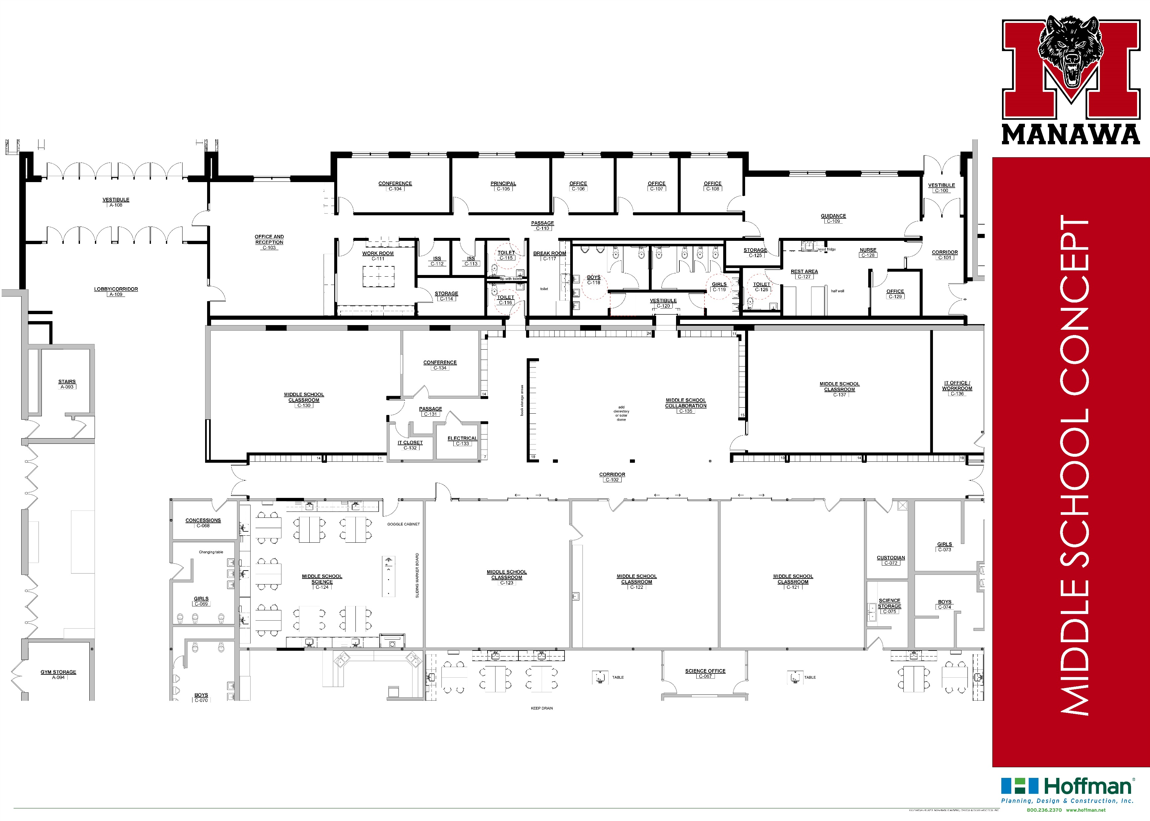
Concept Features
Middle school is separated from the school by doors at both ends of the corridor
Middle school lockers will be contained within the middle school area
Toilet rooms and staff toilet are provided within the middle school area
Provide middle school collaboration area by removing walls from two classrooms
Provide sliding glass doors in existing walls to promote access to collaboration areas
Provide flexible furnishings and writable walls in collaboration area
Provide new science lab for middle school

Slide 9
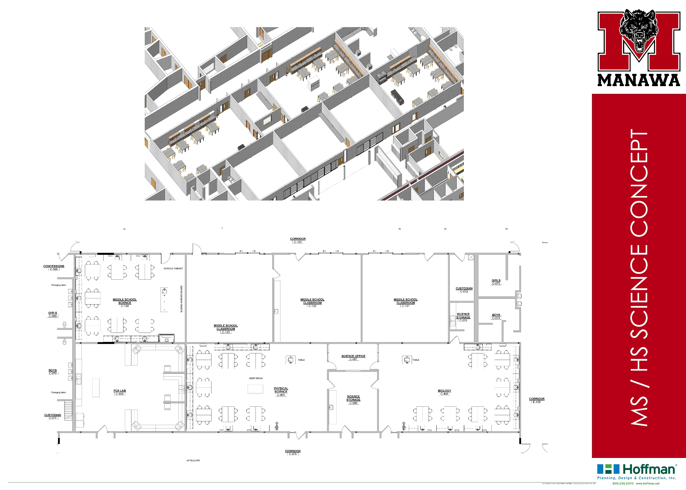
Concept Features
Remove existing lab stations and casework
Provide new fixed classroom casework for lab stations with movable lab tables for flexibility
Update science lab infrastructure including electrical, plumbing, gas and ventilation
Provide lab stations for 28 students in all labs including new middle school lab

Slide 10
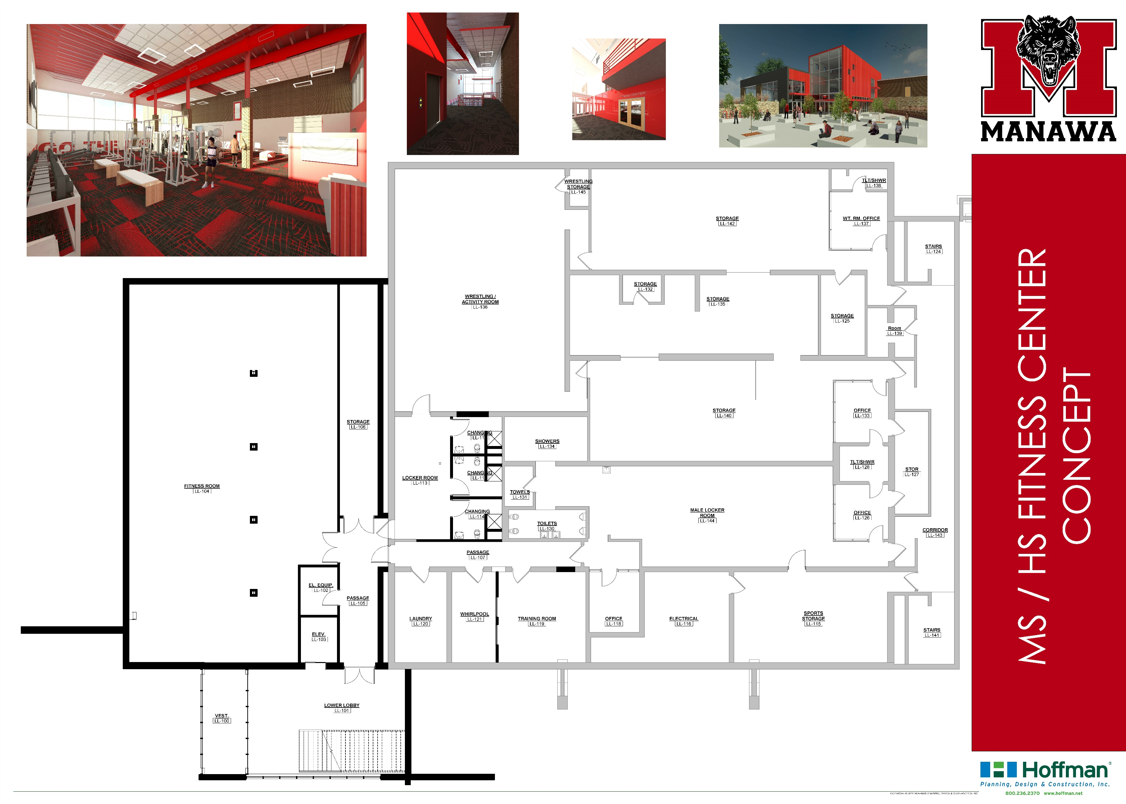
Concept Features
Create new two-story entry from west parking lot including open stairway to second level and elevator serving existing locker rooms area and main floor of school
Create new school and community fitness center with separate entrance that can be open without opening the entire school
Create changing rooms and locker area for community members to use fitness center
Allow for future addition of fitness mezzanine inside new fitness center
Old weight room area is available for storage and other uses

